Slide 1
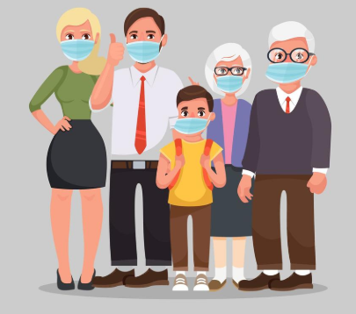
Wearing a Face Mask Coronavirus Protection
Created by John McNally, Student Speech and Language Therapist, under the supervision of Michelle O’Donoghue, SLT, CORU reg 018688

Slide 2
How to use this social story
Social stories™ are short, simple stories that help people to understand what is going on (Gray 2010).
During this pandemic, there has been a lot of change. Social stories are very helpful to understand some of these changes.
Follow these steps when using this social story:
Read this story to your child before you put their mask on
When possible read this story to your child in a quiet and calm environment.
Tell your child what you will do, e.g. “This story is about wearing a face mask. Let's read it together”.
Maintain a positive, reassuring and patient attitude when reviewing the story.
Review the story as often as required - some social stories will be reviewed once a day, others just before the situation for which they were written.
As your child gets used to the new situation and the story no longer seems necessary, you can phase out the story. For example, you can read it only when your child is having difficulty wearing their mask or perhaps occasionally just to refresh their memory
It is a good idea to personalise this social story. The following are examples of how you can do this:
Page 1 – insert a picture of your family
Page 5 – use a picture of the mask you would like your child to wear
Page 11 – Insert a picture of your child with their mask on
Change the colour of the background on each page to your child’s favourite colour
You can customize any page in the social story as long as the message remains consistent
We hope that you enjoy using this social story
Reference: Gray, C. (2010) The New Social Story™ Book, Future Horizons: Texas.

Slide 3
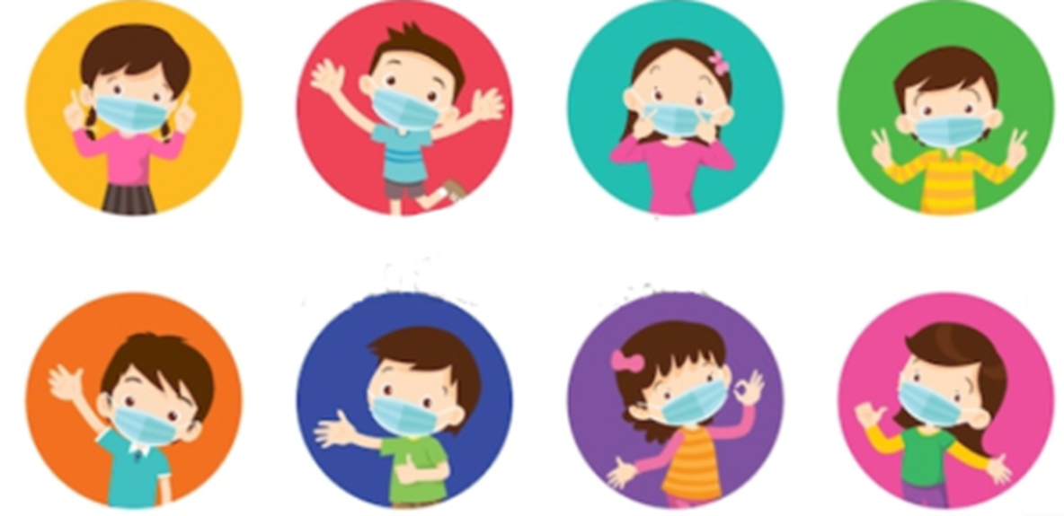
This is a story about why you, me and everybody should wear a face mask to protect us from the coronavirus…

Slide 4
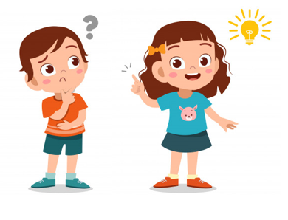
What is a face mask?

Slide 5
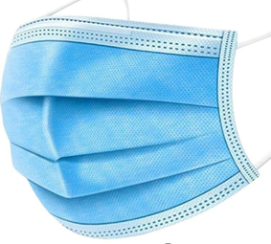
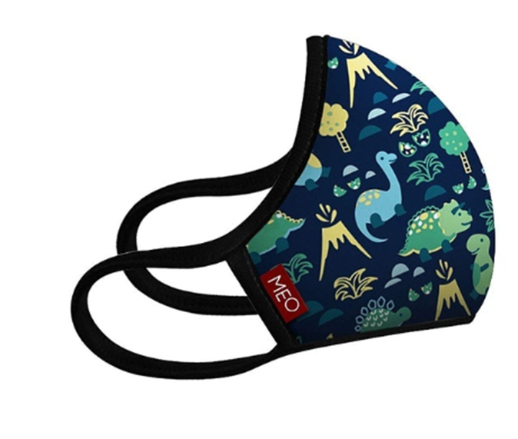
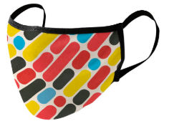
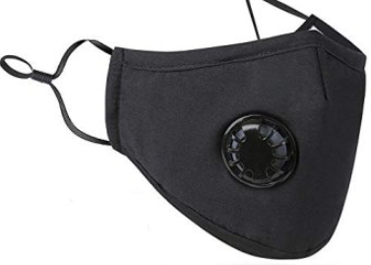
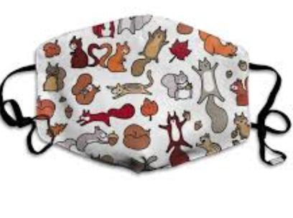
A face mask is made of fabric and can look like any of these

Slide 6
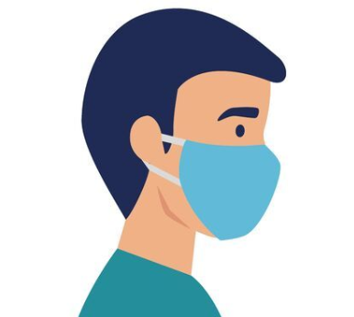
A face mask is something you wear over your mouth and your nose. You wear a mask when you are not in your home.

Slide 7
Why do I need to wear a face mask?

Slide 8
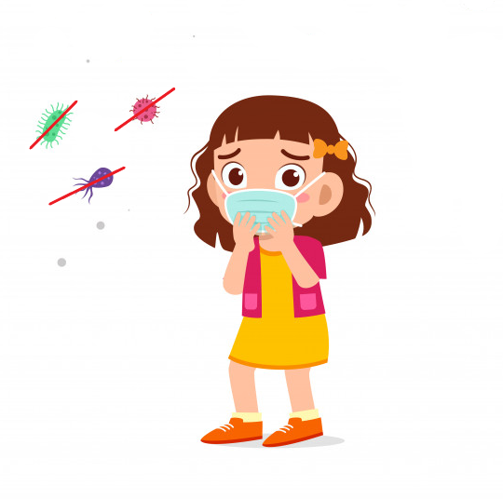
We use a face mask to stop us from breathing in the coronavirus.

Slide 9
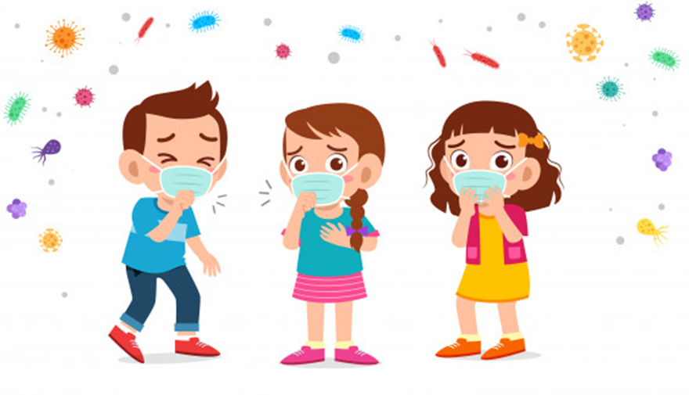
If we are sick, a face mask stops us from giving the coronavirus to other people when we cough or sneeze

Slide 10
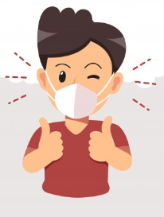
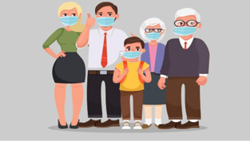
Face masks protect
Me
My family
My friends
My doctor
My carers

Slide 11
When should I wear a face mask?

Slide 12
You wear your face mask any time you go outside your house

Slide 13
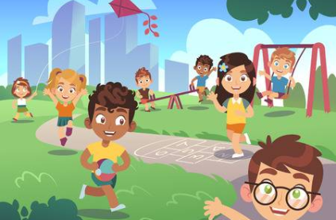
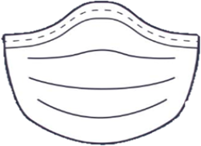
You wear your face mask when you are in the park or playground

Slide 14
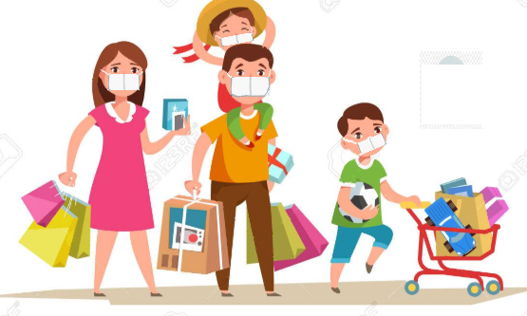
You wear your face mask when you go shopping

Slide 15
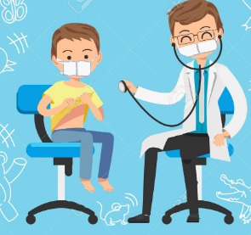
You wear your face mask when you are at the clinic with your doctor or therapist

Slide 16
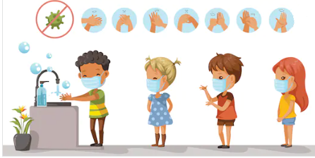
Remember! Even when you are wearing your face mask… You should wash your hands to kill the coronavirus

Slide 17
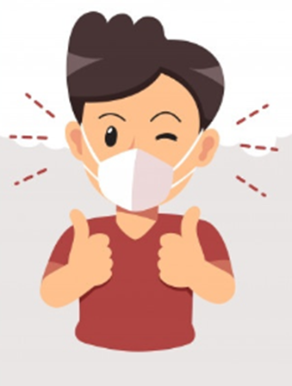
Even though you might not like wearing your face mask… And it might be a little bit uncomfortable… Remember… It is important to wear it when you are outside your house

Slide 18
How do I wear a face mask?

Slide 19
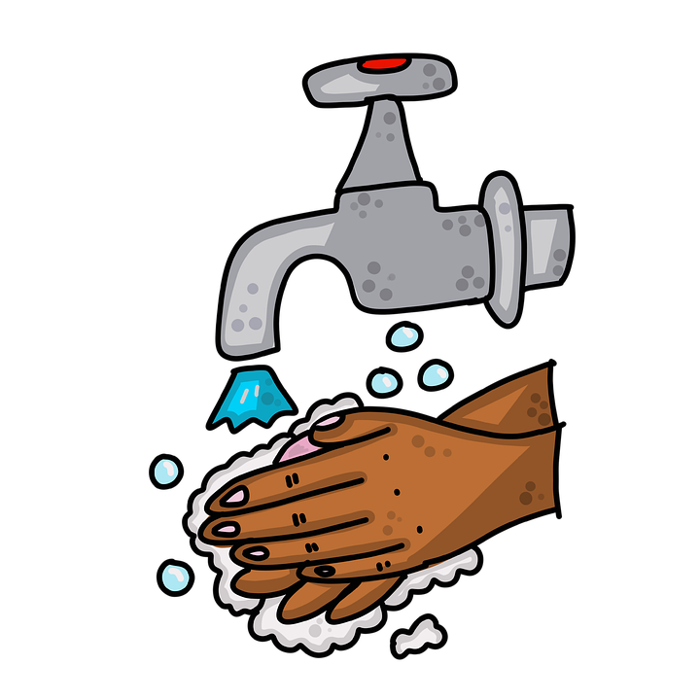
First, clean your hands with soap

Slide 20
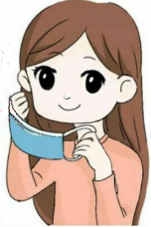
Hold the mask by the ear loops. Place the ear loops around your ears and the mask over your face

Slide 21
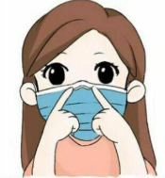
Push the mask tight against your nose. Make sure it covers your mouth and nose completely.

Slide 22
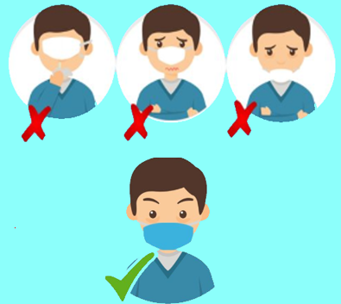
You can ask a grown up for help to make sure you are wearing your mask correctly…
It should look like this when it is on…

Slide 23
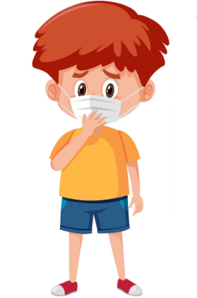
Try not to touch your face when you are wearing your mask

Slide 24
When you get home take off your mask… Wash your hands right away…. Ask a grown up to wash your mask.

Slide 25
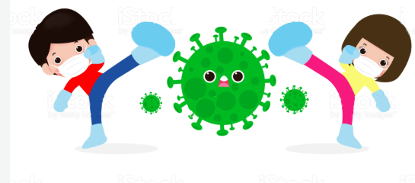
Wearing your face mask helps to fight the coronavirus and to protect you and everybody else

Slide 26
References Image page 1: https://www.vecteezy.com/vector-art/831234-family-wearing-protective-medical-masks Image page 2: https://www.shutterstock.com/image-vector/children-wearing-surgical-mask-prevent-virus-1631021197 Image page 3, 6, 11, 18: https://www.freepik.com/premium-vector/kid-boy-thinking-face_5136153.htm Image page 4:https://www.pksaonline.com/index.php?main_page=product_info&products_id=114990 Image page 5: https://es.123rf.com/photo_145179230_stock-vector-man-using-face-mask-sick-of-covid-19-vector-illustration-design.html Image page 7: https://www.bigstockphoto.com/es/image-362022973/stock-vector-crowd-of-infected-and-healthy-people-outside-during-corona-virus-outbreak-men-and-women-protecting Image page 8: https://www.freepik.com/premium-vector/cute-kids-girl-wearing-face-mask-health_6296063.htm Image page 9: https://www.freepik.com/premium-vector/cute-kids-boy-girl-wearing-face-mask_6475096.htm Image page 10: https://www.vecteezy.com/vector-art/831234-family-wearing-protective-medical-masks Image page 12: https://www.crushpixel.com/stock-vector/children-wear-medical-face-mask-1874784.html Image page 13: https://es.123rf.com/clipart-vector/kids_playing.html?sti=m29r4x7az7a458vkpt|&mediapopup=118507813 Image page 14: https://es.123rf.com/clipart-vector/children_shopping.html?sti=lqlfyqb5zntxmdlrx1|&mediapopup=81381606 Image page 15: https://es.123rf.com/photo_85325323_stock-vector-children-s-clinic-treatment-is-not-terrible-feeling-relax-.html Image page 16: https://www.pngfuel.com/free-png/nxplq Image page 17: https://www.freepik.com/premium-vector/air-pollution-concept-man-coughing-wearing-protective-face-mask-against-smoke_7022721.htm Image page 19: https://www.pngguru.com/free-transparent-background-png-clipart-mudmh Image page 20: https://tianascloset.com/index.php/2020/04/05/how-to-wear-your-face-masks-the-right-way/ Image page 21: https://deepgreenpermaculture.com/2020/04/06/how-to-safely-put-on-use-and-remove-a-face-mask-to-protect-against-covid-19-coronavirus/ Image page 22:https://e-shop.ie/500-pcs-surgical-3-ply-face-mask-in-ireland/p929477c40811 Image page 23:https://e-shop.ie/500-pcs-surgical-3-ply-face-mask-in-ireland/p929477c40811 Image page 24: :https://www.facebook.com/affinitydental.bgc/photos/a.767870169996152/2658726557577161/?type=3&theatre Image page 25: https://www.vectorstock.com/royalty-free-vector/sick-boy-wearing-mask-on-white-background-vector-29224598 Image page 26: https://www.istockphoto.com/ie/vector/people-fight-with-coronavirus-cartoon-character-man-and-woman-attack-covid-19-gm1214372541-353288581

